Slide 1

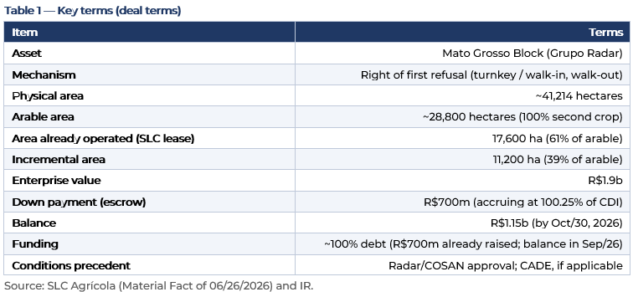
June 30 of 2026
Genial Institucional S.A. CCTVM
Equity
Research
Agribusiness
Acquisition of the Mato Grosso Block
Agribusiness
The Fact
On 26-Jun-2026 SLC Agrícola announced, via a Material Fact, the irrevocable exercise of its right of first refusal over the Radar Group’s “Mato Grosso Block” portfolio: ~41.2k physical hectares (~28.8k arable), for R$1.85b. The Company already operated 17.6k ha (61% of the area) under lease — so the deal is mostly an internalization of already-farmed area (lease-to-own).
We incorporate IR-team clarifications on the deal: (i) the price embeds a discount to the regional comp; (ii) company-guided leverage is ~2.7x 26E; and (iii) there is material completion risk (deal/legal risk), with incremental generation deferred to the 28/29 crop.
Assumptions. Funding ~100% new debt (R$700m already raised; balance in Sep/26); cost of debt 14.9% p.a. (CDI+0.25%, CDI ~14.65%); income tax 34%. Leverage on two bases: 1Q26 LTM snapshot (implied EBITDA R$2.426b = R$6.6b net debt ÷ 2.72x) and company guidance of ~2.7x 26E (implied full EBITDA ~R$3.13b). Regional comp of R$75–80k/ha and timing (28/29 crop) per IR on 26-Jun-2026; lease estimated via a 4–5% cap rate on land value of R$59,534/ha. Figures in current R$.
1. Deal summary
The R$700m signal (in escrow, yielding 100.25% of CDI) has already been raised from banks; the R$1.15b balance will be raised in September, shortly before the October payment. The deal is therefore essentially financed by new debt.
2. Deal structure and completion (deal/legal) risk
Critical point clarified by IR: SLC held the right of first refusal only over its own share (the 17.6k ha it leases). As the Bom Futuro Group bid for the entire area, Radar notified SLC to exercise the right on an all-or-nothing basis. Per the Company, this obligation to take the full block is legally questionable: there is case law for urban real estate, but no precedent in the agricultural sphere.
Analysts
Luca Vello
+55 (11) 3206-1457
luca.vello@genial.com.vc
Company
SLCE3 BZ Equity
Hold
Price: R$12.96 (30-Jun-2026)
Target Price 12M: R$18.00
www.bancogenial.com
Genial Institucional S.A. CCTVM
Av Brig Faria Lima, 3400 – 9th floor

Slide 2

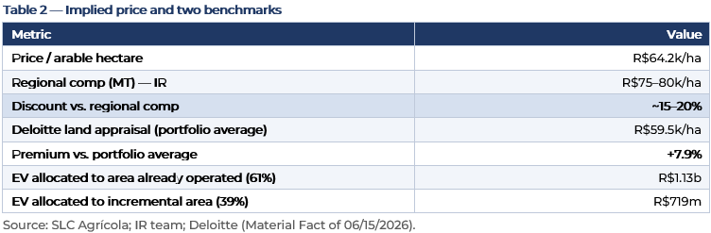
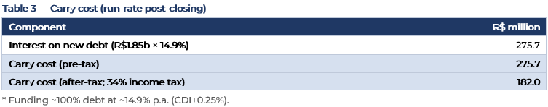
June 30 of 2026
Genial Institucional S.A. CCTVM
Equity
Research
For the stock, this note’s figures describe the deal as announced, but with uncertain completion probability and timeline. The R$700m signal disbursement (interest-bearing escrow) is the immediate cash commitment; the bulk of the impact only materializes at closing.
3. Price paid (per hectare)
Against Deloitte’s portfolio average (R$59.5k/ha, blending all regions), the R$64.2k/ha price looks like a slight premium (+7.9%). But IR notes this MT region is worth R$75–80k/ha, implying a ~15–20% discount vs. the regional comp — the more appropriate benchmark for this asset. Moreover, the sale is turnkey: silo, cotton gin and warehouse are included in the price (infra value not yet disclosed), widening the effective discount on the bare land.
4. Pro forma leverage
The funding mix does not change net debt — raising debt lifts gross debt and cash equally. What lifts net debt is the R$1.85b disbursement to buy the land (a non-cash asset), regardless of how it is paid.
On the 1Q26 LTM (R$2.4b, a seasonal/cyclical trough), pro forma leverage would be ~3.48x. The company itself guides ~2.7x 26E even paying it all within the year, which would embed a full EBITDA of ~R$3.1b (margin recovery through the year and crop cash inflow in 2H). The ~2.7x 26E is substantially more comfortable than the trough snapshot and reduces the balance-sheet risk the market might perceive.
5. Annual carry cost
With funding essentially in debt, the run-rate carry is ~R$276m/yr Est. pre-tax (~R$182m post-tax). In the interim, the R$700m signal in escrow earns ~CDI (100.25%), partly offsetting that tranche’s cost until closing; the full carry only runs after the October closing.
www.bancogenial.com
Genial Institucional S.A. CCTVM
Av Brig Faria Lima, 3400 – 9th floor

Slide 3
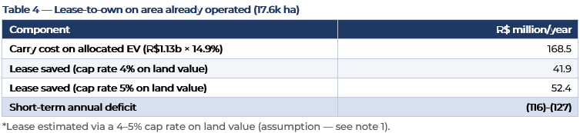

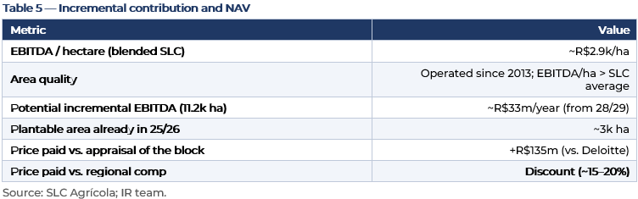
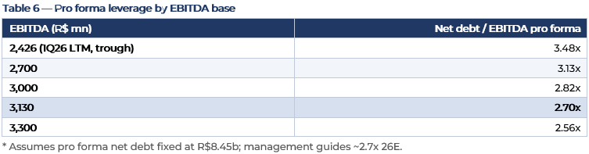
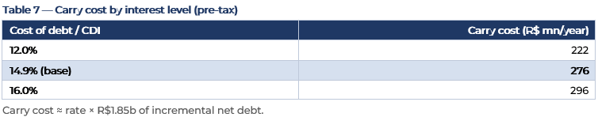
June 30 of 2026
Genial Institucional S.A. CCTVM
Equity
Research
6. Lease-to-own economics
For the 17.6k ha SLC already leased, we compare the allocated carry cost against the lease no longer paid.
You pay ~R$169m of carry to save ~R$42–52m of lease — a deficit of ~R$116–127m/yr Est.. The land-appreciation break-even to cover the deficit is +11% per year vs. +1.0% y/y at the last revaluation. At ~15% rates, the internalization should be read as a play on land control and tenure security and capturing the entry discount, not near-term cash savings.
7. EBITDA timing and NAV
The incremental area’s EBITDA upside is real, but deferred to 28/29, which reduces near-term cash accretion to roughly the internalization of the own lease plus the ~3k ha already plantable. On NAV, the price sits above Deloitte’s appraisal (~+R$135m) but below the regional comp cited by IR; if the regional value is confirmed, there is mark-to-market optionality on the asset above the acquisition value.
8. Sensitivity scenarios
www.bancogenial.com
Genial Institucional S.A. CCTVM
Av Brig Faria Lima, 3400 – 9th floor

Slide 4
June 30 of 2026
Genial Institucional S.A. CCTVM
Equity
Research
The levers that matter most for the stock: (i) the legal outcome (completes or not), (ii) the rate path (carry), and (iii) EBITDA recovery (leverage). With completion confirmed, the combination of Selic cuts and margin normalization in 2026 should keep leverage near ~2.7x 26E and reduce the carry.
9. Synthesis
IR’s clarifications improve asset quality and the entry price (MT land at a ~15–20% discount to the regional comp, turnkey, company-guided leverage of ~2.7x 26E), but introduce two material detractors: (i) completion risk from the all-or-nothing legal dispute (Bom Futuro and another lessee are likely to litigate); and (ii) the deferral of incremental generation to the 28/29 crop, which pushes cash accretion forward.
What to watch. Radar/COSAN’s response to the proposal and any litigation by Bom Futuro / Alexandre Bortolo; funding confirmation (the R$1.15b balance in Sep/26); 2026 EBITDA validating the margin recovery underpinning ~2.7x; the Selic/CDI path (the main carry driver); and the infra value (turnkey) and the actual lease rate paid to Radar, to calibrate the effective price.
www.bancogenial.com
Genial Institucional S.A. CCTVM
Av Brig Faria Lima, 3400 – 9th floor

Slide 5
June 30 of 2026
Genial Institucional S.A. CCTVM
Equity
Research
Disclosure Section
1. GENERAL DISCLAIMER
This report has been produced by the research department (“Genial Institutional Research”) of Genial Institutional Corretora de Câmbio, Títulos e Valores Mobiliários S.A. (“GENIAL INSTITUTIONAL CCTVM”). Genial Institutional is a brand name of Genial Investimentos CCTVM.
This report may not be reproduced or redistributed to any other person, in whole or in part, for any purpose, without the prior written consent of GENIAL INSTITUTIONAL CCTVM. GENIAL INSTITUTIONAL CCTVM accepts no liability whatsoever for the actions of third parties in this respect.
This research report is for distribution only under such circumstances as may be permitted by applicable law. This research report has no regard to the specific investment objectives, financial situation or particular needs of any specific recipient, even if sent only to a single recipient. This research report is not guaranteed to be a complete statement or summary of any securities, markets, reports or developments referred to in this research report. Neither GENIAL INSTITUTIONAL CCTVM nor any of its directors, officers, employees or agents shall have any liability, however arising, for any error, inaccuracy or incompleteness of fact or opinion in this research report or lack of care in this research report’s preparation or publication, or any losses or damages which may arise from the use of this research report
GENIAL INSTITUTIONAL CCTVM may rely on information barriers, such as “Chinese Walls” to control the flow of information within the areas, units, divisions, groups, or affiliates of GENIAL INSTITUTIONAL CCTVM.
Investing in any non-U.S. securities or related financial instruments (including ADRs) discussed in this research report may present certain risks. The securities of non-U.S. issuers may not be registered with, or be subject to the regulations of, the U.S. Securities and Exchange Commission. Information on such non-U.S. securities or related financial instruments may be limited. Foreign companies may not be subject to audit and reporting standards and regulatory requirements comparable to those in effect within the United States.
The value of any investment or income from any securities or related financial instruments discussed in this research report denominated in a currency other than U.S. dollars is subject to exchange rate fluctuations that may have a positive or adverse effect on the value of or income from such securities or related financial instruments.
Past performance is not necessarily a guide to future performance and no representation or warranty, express or implied, is made by GENIAL INSTITUTIONAL CCTVM with respect to future performance. Income from investments may fluctuate. The price or value of the investments to which this research report relates, either directly or indirectly, may fall or rise against the interest of investors. Any recommendation or opinion contained in this research report may become outdated as a consequence of changes in the environment in which the issuer of the securities under analysis operates, in addition to changes in the estimates and forecasts, assumptions and valuation methodology used herein.
The locally listed shares of Brazilian companies may only be purchased by investors outside of Brazil who are “eligible investors” within the meaning of applicable laws and regulations.
www.bancogenial.com
Genial Institucional S.A. CCTVM
Av Brig Faria Lima, 3400 – 9th floor

Slide 6
June 30 of 2026
Genial Institucional S.A. CCTVM
Equity
Research
2. ANALYST(S) DISCLOSURES AND CERTIFICATION
The principal analyst, LUCA VELLO, is responsible for the content of this report and for meeting the requirements of Securities and Exchange Commission of Brazil (CVM) Instruction 598/2018.
The analysts hereby certify that the views expressed in this research report accurately reflect their personal views about the subject securities or issuers and it was prepared in an independent manner, including with respect to the person and to GENIAL INSTITUTIONAL.
The analyst hereby certifies that he (she) has no connection with any individual who works for the issuer(s) discussed in this report.
The analyst hereby certifies that he (she), or his (her) spouse or companion, either directly or indirectly, in his or her own name or on behalf of a third party, does not hold any of the securities covered in this report.
The analyst hereby certifies that he (she), or his (her) spouse or companion, is not directly or indirectly involved in the purchase, disposal or brokering of the securities covered in this report.
The analyst hereby certifies that he (she), or the his (her) spouse or companion, has no direct or indirect financial interest in the issuer covered in this report (other than trading shares in investment funds, in which the analyst cannot control, directly or indirectly, the administration or management of the fund, or which do not concentrate investments in sectors or companies that are covered by reports produced by the analyst).
The analyst’s compensation is, directly or indirectly, determined by income from GENIAL INSTITUTIONAL´s business and financial operations.
In addition, the analysts certify that no part of their compensation was, is, or will be directly or indirectly related to the specific recommendations or views expressed in this research report.
The compensation of the analyst who prepared this report is determined by research management and senior management (not including investment banking). Analyst compensation is not based on investment banking revenues, however, compensation may relate to the revenues of GENIAL INSTITUTIONAL CCTVM, its affiliates and/or subsidiaries as a whole, of which investment banking, sales and trading are a part. Compensation paid to analysts is the sole responsibility of GENIAL INSTITUTIONAL CCTVM.
The analyst hereby certifies that he (she), or his (her) spouse or companion, does not serve as an officer, director, or advisory board member of the subject company.
The principal analyst is responsible for the content of this report and for meeting the requirements of Securities and Exchange Commission of Brazil (CVM) Instruction 598/2018.
Unless otherwise stated, the individuals listed on the cover page of this report are research analysts.
www.bancogenial.com
Genial Institucional S.A. CCTVM
Av Brig Faria Lima, 3400 – 9th floor

Slide 7
June 30 of 2026
Genial Institucional S.A. CCTVM
Equity
Research
3. ADDITIONAL DISCLOSURE
(i) This document was prepared by GENIAL INSTITUTIONAL Research and is hereby supplied for the sole purpose of providing information about companies and their securities.
(ii) The information contained herein is provided for informational purposes only and does not constitute an offer to buy or sell, and should not be construed as a solicitation to acquire, any securities in any jurisdiction. The opinions expressed herein regarding the purchase, sale or holding of securities, or with respect to the weighting of such securities in a real or hypothetical portfolio, are based on careful analysis by the analysts who prepared this report and should not be construed by current or future investors as recommendations for any particular investment decision or action. The investor’s final decision should be made considering all of the risks and fees involved. This report is based on information obtained from primary or secondary public sources, or directly from companies, and is combined with estimates and calculations prepared by GENIAL INSTITUTIONAL CCTVM. This report does not purport to be a complete statement of all material facts related to any company, industry, security or market strategy mentioned. The information has been obtained from sources believed to be reliable, but GENIAL INSTITUTIONAL CCTVM does not make any express or implied representation or warranty as to the completeness, reliability or accuracy of such information. The information, opinions, estimates and projections contained in this document are based on current data and are subject to change. Prices and availability of financial instruments are indicative only and subject to change without notice. GENIAL INSTITUTIONAL CCTVM is under no obligation to update or revise this document or to advise of any changes in such data.
(iii)The securities discussed in this report, as well as the opinions and recommendations contained herein, may not be appropriate for every type of investor. This report does not take into account the investments objectives, financial situation or particular needs of any particular investor. Investors who wish to buy, sell or invest in securities that are covered in this report should seek independent financial advice that takes individual characteristics and needs into consideration, before making any investment decision with respect to the securities in question. Each investor should make independent investment decisions after carefully analyzing the risks, fees and commissions involved. If a financial instrument is denominated in a currency other than an investor’s currency, changes in exchange rates may adversely affect the price or value of, or the income derived from the financial instrument, and the reader of this report assumes all foreign exchange risks. Income from financial instruments may vary, and therefore their price or value may rise or fall, either directly or indirectly. The information, opinions and recommendations contained in this report do not constitute and should not be interpreted as a promise or guarantee of a particular return on any investment. Past performance does not necessarily indicate future results, and no representation or warranty, express or implied, is made herein regarding future performance. Therefore, GENIAL INSTITUTIONAL CCTVM, its affiliated companies, and the analysts involved in this report take no responsibility for any direct, indirect or consequential loss resulting from the use of the information contained in this report, and anyone using this report undertakes to irrevocably indemnify GENIAL INSTITUTIONAL CCTVM and its affiliates from any claims and demands.
(iv) Prices in this report are believed to be reliable as of the date on which this report was issued and are derived from one or more of the following: (i) sources as expressly specified alongside the relevant data; (ii) the quoted price on the main regulated market for the security in question; (iii) other public sources believed to be reliable; or (iv) GENIAL INSTITUTIONAL CCTVM’s proprietary data or data available to GENIAL INSTITUTIONAL CCTVM.
www.bancogenial.com
Genial Institucional S.A. CCTVM
Av Brig Faria Lima, 3400 – 9th floor

Slide 8
June 30 of 2026
Genial Institucional S.A. CCTVM
Equity
Research
(v) No representation or warranty, either express or implied, is provided in relation to the accuracy, completeness or reliability of the information contained herein, except with respect to information concerning GENIAL INSTITUTIONAL CCTVM, its subsidiaries and affiliates. In all cases, investors should conduct their own investigation and analysis of such information before taking or omitting to take any action in relation to securities or markets that are analyzed in this report.
(vi)GENIAL INSTITUTIONAL CCTVM makes no representations herein that investors will obtain profits. GENIAL INSTITUTIONAL CCTVM will not share with investors any investment profits nor accept any liability for any investment losses. Investments involve risks and investors should exercise prudence in making their investment decisions. GENIAL INSTITUTIONAL CCTVM accepts no fiduciary duties on behalf of recipients of this report and in communicating this report is not acting in a fiduciary capacity. This report is not to be relied upon in substitution for the exercise of recipient’s independent judgment. Opinions, estimates, and projections expressed herein constitute the current judgment of the analyst responsible for the substance of this report as of the date on which the report was issued and are therefore subject to change without notice and may differ or be contrary to opinions expressed by other business areas or groups of GENIAL INSTITUTIONAL CCTVM as a result of using different assumptions and criteria. The information, opinions and recommendations contained in this report do not constitute and should not be interpreted as a promise or guarantee of a particular return on any investment.
(vii)Because the personal views of analysts may differ from one another, GENIAL INSTITUTIONAL CCTVM, its subsidiaries and affiliates may have issued or may issue reports that are inconsistent with, and/or reach different conclusions from, the information presented herein. Any such opinions, estimates, and projections must not be construed as a representation that the matters referred to therein will occur. Prices and availability of financial instruments are indicative only and subject to change without notice. Income from financial instruments may vary, and therefore their price or value may rise or fall, either directly or indirectly.
(viii)This document may not be: (a) photocopied or duplicated in any manner, in whole or in part, and/or (b) distributed without GENIAL INSTITUTIONAL CCTVM’s prior written consent. GENIAL INSTITUTIONAL CCTVM accepts no liability whatsoever for the actions of third parties in this respect.
(ix)Neither GENIAL INSTITUTIONAL CCTVM nor any of its affiliates, nor any of their respective directors, employees or agents, accepts any liability for any loss or damage arising out of the use of all or any part of this report.
(x) GENIAL INSTITUTIONAL CCTVM (or its affiliates, officers, directors or employees) may, to the extent permitted by law, have acted upon or used the information herein contained before the publication of this report and may have a position in securities issued by the companies mentioned herein and may make a market or act as a principal in any transactions in any such securities. Genial Institutional may from time to time perform investment banking or other services to, or solicit investment banking or other business from, the companies mentioned herein.
www.bancogenial.com
Genial Institucional S.A. CCTVM
Av Brig Faria Lima, 3400 – 9th floor

Slide 9
June 30 of 2026
Genial Institucional S.A. CCTVM
Equity
Research
4. IMPORTANT DISCLOSURES FOR U.S. PERSONS
This research report was prepared by Genial Institutional CCTVM, a company authorized to engage in securities activities in Brazil. Genial Institutional CCTVM is not a registered broker-dealer in the United States and, therefore, is not subject to U.S. rules regarding the preparation of research reports and the independence of research analysts. This research report is provided for distribution to “major U.S. institutional investors” in reliance on the exemption from registration provided by Rule 15a-6 of the U.S. Securities Exchange Act of 1934, as amended (the “Exchange Act”) and is not being provided pursuant to a soft-dollar arrangement.
Any U.S. recipient of this research report wishing to effect any transaction to buy or sell securities or related financial instruments based on the information provided in this research report should do so only through Auerbach Grayson & Company LLC ("AGCO"), a registered broker dealer in the United States with an office at 20 West 55th Street New York, NY 10019, (212) 453-3523 . Under no circumstances should any recipient of this research report effect any transaction to buy or sell securities or related financial instruments through Genial Institutional CCTVM.
If the report is to be distributed to anyone other than Major U.S. Institutional Investors in the United States. AGCO accepts responsibility for the contents of this report as provided for in relevant SEC releases and SEC staff no-action letters.
The analyst whose name appears in this research report is not registered or qualified as a research analyst with the Financial Industry Regulatory Authority (“FINRA”) and may not be an associated person at Auerbach Grayson & Company LLC ("AGCO") and, therefore, may not be subject to applicable restrictions under FINRA Rules on communications with a subject company, public appearances and trading securities held by a research analyst account.
The disclosures contained in research reports produced by GENIAL INSTITUTIONAL CCTVM and distributed by Auerbach Grayson & Company LLC ("AGCO") in the U.S. shall be governed by and construed in accordance with U.S. law. This report may not be reproduced or redistributed to any other person, in whole or in part, for any purpose, without the prior written consent of GENIAL INSTITUTIONAL CCTVM. Additional information relative to the financial instruments discussed in this report is available upon request.
UK Disclaimer:
(i) This document is STRICTLY CONFIDENTIAL to the recipient, may not be distributed to the press or other media and may not be reproduced in any form. this document is directed only at persons who are “INVESTMENT PROFESSIONALS” falling within article 19(5) of the FSMA 2000 (FINANCIAL PROMOTION) ORDER 2005, or HIGH NET WORTH BODIES falling within ARTICLE 49(2) of that order (together THE “RELEVANT PERSONS”). This document must not be acted on or relied on by persons who are not RELEVANT PERSONS.
(ii) The distribution of this document in other jurisdictions may be restricted by law and persons into whose possession this document comes should inform themselves about, and observe, any such restrictions. Any failure to comply with these restrictions may constitute a violation of the laws of any such other jurisdiction.
Copyright 2024 GENIAL INSTITUTIONAL CCTVM
www.bancogenial.com
Genial Institucional S.A. CCTVM
Av Brig Faria Lima, 3400 – 9th floor

